Slide 1



Grocery Store Management

Slide 2


Agenda
Objective of the Project
ER Diagram and schema explanation
About Tables
Key analysis questions
SQL query results with screenshots
Final business insights and recommendations
Conclusion
Q&A Slide
Experience/Challenges

Slide 3
Objective
Looking at which suppliers bring the most value by analyzing how many different products they provide, their average pricing, and the total revenue they generate. This will help identify the most active and profitable partners.
Evaluating how efficiently employees are working by tracking the number of orders they process, the total value of those orders, and the average size of each order. This will give a clear view of individual and team performance.
Dive deeper into sales trends at the product level. Examine how order quantities relate to pricing, what the average order quantity is for each product, and how prices vary across different orders. This will highlight key buying patterns.
Finding to strengthen supplier relationships, boost employee productivity, adjust product pricing strategies, and improve overall sales performance.

Slide 4

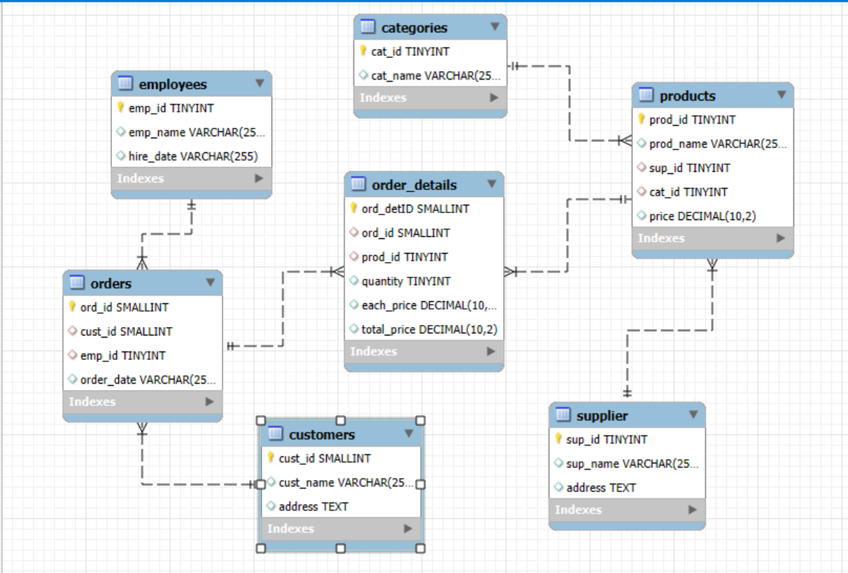
ER Diagram and schema explanation
One-to-Many from supplier to products
One-to-Many from categories to products
One-to-Many from products to order_details
One-to-Many from orders to order_details
One-to-Many from customers to orders
One-to-Many from employees to orders

Slide 5
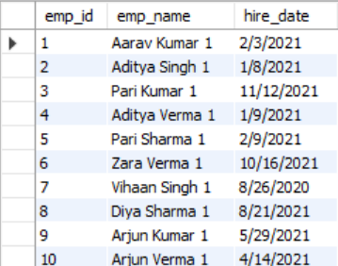
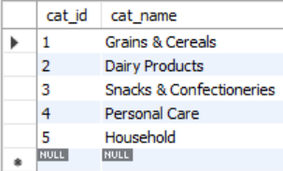
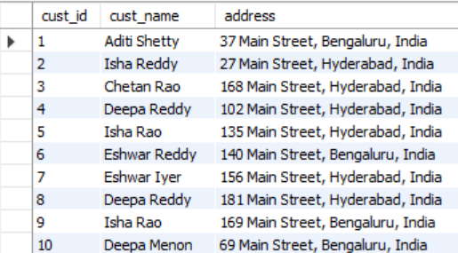
Tables
1. categories
2. employees
3. customers

Slide 6
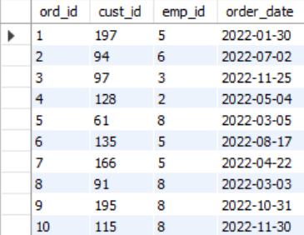
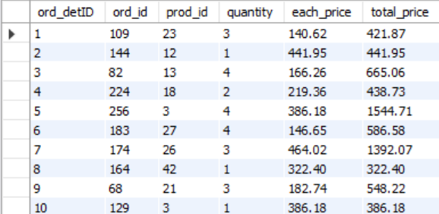
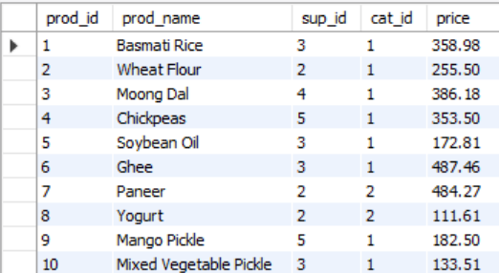
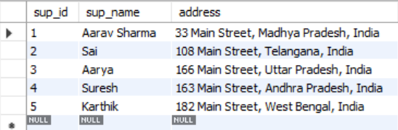
Tables
4. order_details
5. orders
7. supplier
6. products

Slide 7
Key analysis questions
How many unique customers have placed orders?
Which customers have placed the highest number of orders?
What is the total and average purchase value per customer?
Who are the top 5 customers by total purchase amount?
How many products exist in each category?
What is the average price of products by category?
Which products have the highest total sales volume (by quantity)?
What is the total revenue generated by each product?
How do product sales vary by category and supplier?
How many orders have been placed in total?
What is the average value per order?
On which dates were the most orders placed?
What are the monthly trends in order volume and revenue?
How do order patterns vary across weekdays and weekends?
How many suppliers are there in the database?
Which supplier provides the most products?
What is the average price of products from each supplier?
Which suppliers contribute the most to total product sales (by revenue)?

Slide 8



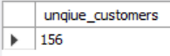
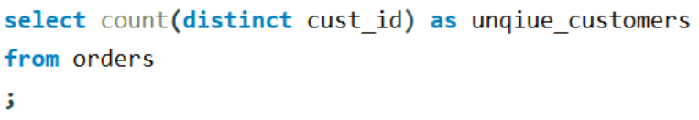


SQL query results with screenshots
1. How many unique customers have placed orders?
Output :
Query :

Slide 9
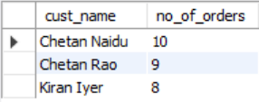
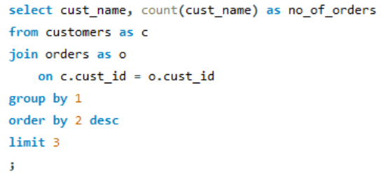
2. Which top 3 customers have placed the highest number of orders?
Output :
Query :

Slide 10
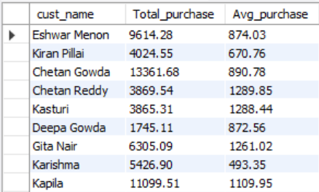
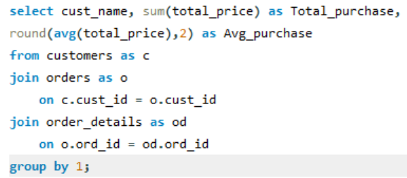
3. What is the total and average purchase value per customer?
Output :
Query :

Slide 11
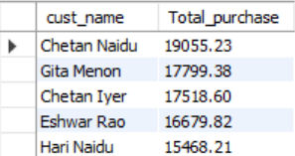
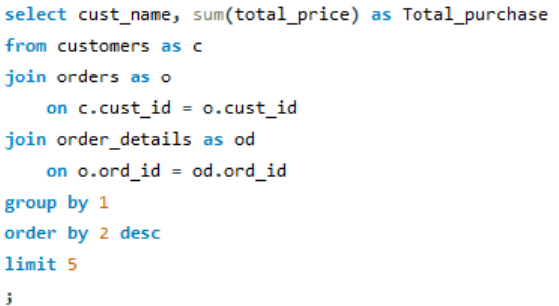
4. Who are the top 5 customers by total purchase amount?
Output :
Query :

Slide 12
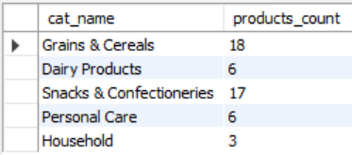
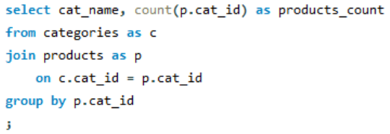
5. How many products exist in each category?
Output :
Query :

Slide 13
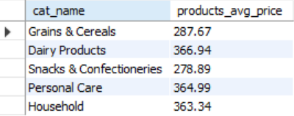
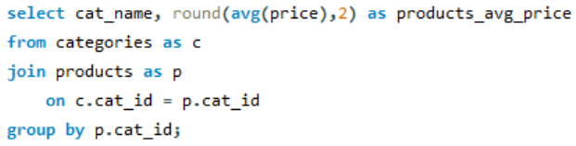
6. What is the average price of products by category?
Output :
Query :

Slide 14
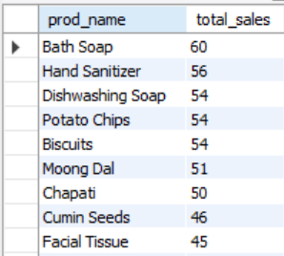
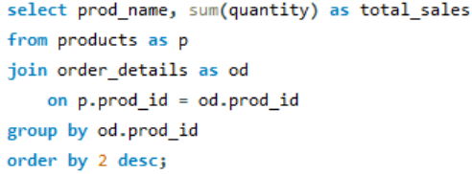
7. Which products have the highest total sales volume (by quantity)?
Output :
Query :

Slide 15
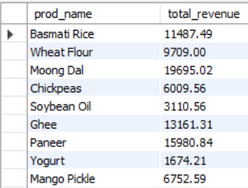
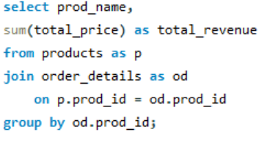
8. What is the total revenue generated by each product?
Output :
Query :

Slide 16
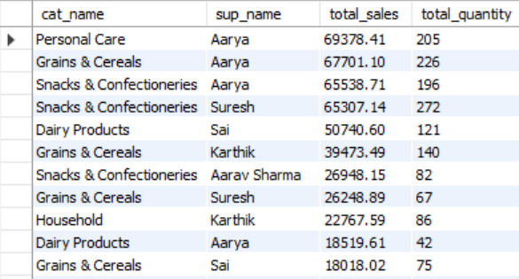
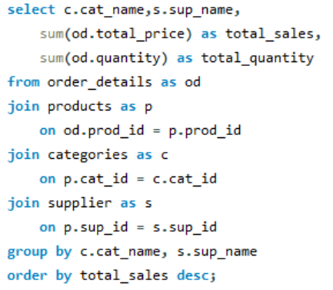
9. How do product sales vary by category and supplier?
Output :
Query :

Slide 17
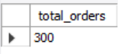
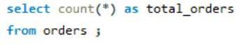
10. How many orders have been placed in total?
Output :
Query :

Slide 18
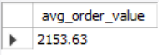
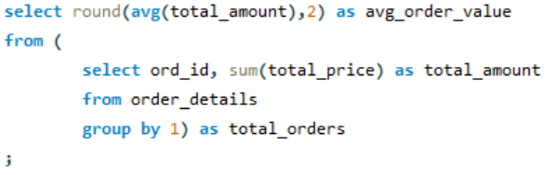
11.What is the average value per order?
Output :
Query :

Slide 19
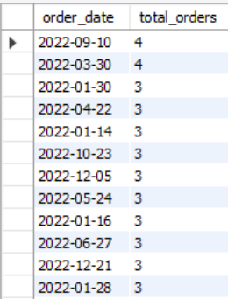
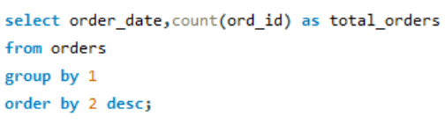
12. On which dates were the most orders placed?
Output :
Query :

Slide 20
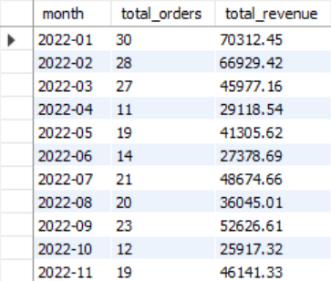
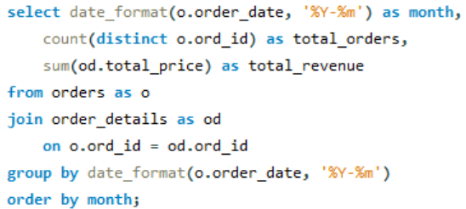
13. are the monthly trends in order volume and revenue?
Output :
Query :

Slide 21
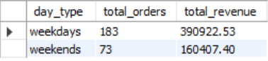
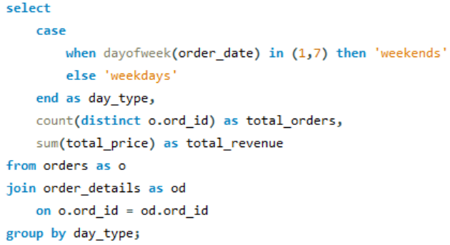
14. How do order patterns vary across weekdays and weekends?
Output :
Query :

Slide 22
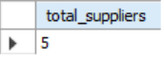
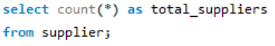
15. How many suppliers are there in the database?
Output :
Query :

Slide 23
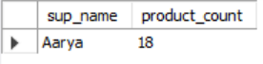
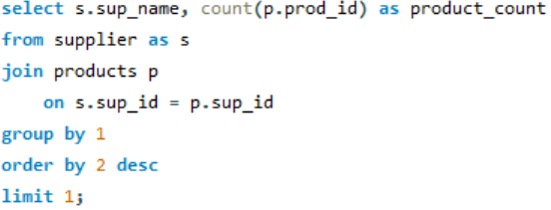
16. Which supplier provides the most products?
Output :
Query :

Slide 24
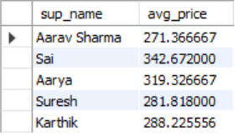
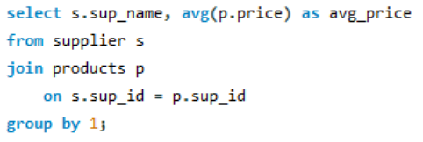
17. What is the average price of products from each supplier?
Output :
Query :

Slide 25
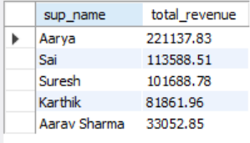
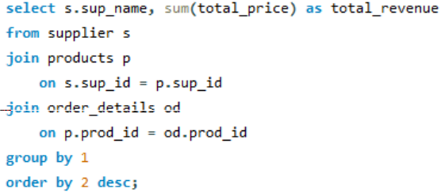
18. Which suppliers contribute the most to total product sales (by revenue)?
Output :
Query :

Slide 26
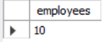
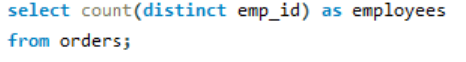
19. How many employees have processed orders?
Output :
Query :

Slide 27
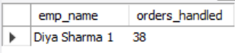
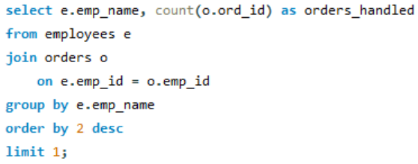
20. Which employees have handled the most orders?
Output :
Query :

Slide 28
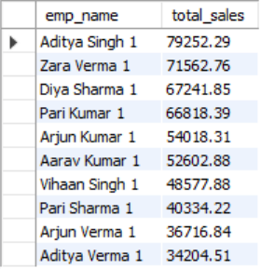
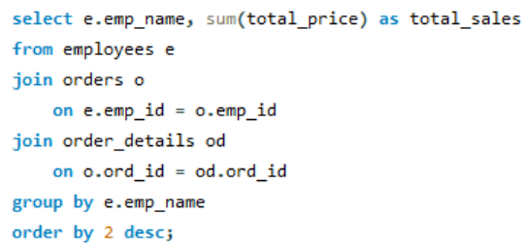
21. What is the total sales value processed by each employee?
Output :
Query :

Slide 29


22. What is the average order value handled per employee?
Output :
Query :

Slide 30


23. What is the relationship between quantity ordered and total price?
Output :
Query :

Slide 31


24. What is the average quantity ordered per product?
Output :
Query :

Slide 32


25. How does the unit price vary across products and orders?
Output :
Query :

Slide 33
Final business insights
The top five customers account for more than 60% of total purchase revenue, showing that sales are heavily concentrated among a core group of loyal buyers.
Products are spread across a wide range of categories, though some categories stand out by generating higher sales volumes and revenue than others.
Monthly trends highlight noticeable peaks in certain months, pointing to clear seasonal buying patterns.
Sales activity is slightly stronger on weekends, with both order counts and revenue higher compared to weekdays.
Leading suppliers contribute significantly to profitability by providing higher-value products.
The top-performing employees process the largest number of orders and generate the highest total sales value.
There is a clear positive link between the quantity of products ordered and total sales value, confirming that revenue growth is strongly volume-driven.

Slide 34
Recommendations
Introduce a loyalty or membership program to reward frequent buyers and retain your highest-spending customers.
Optimize the product mix by focusing on top revenue-generating items and addressing low-performing products that may indicate overstock or weak demand.
Boost marketing and inventory during peak months to take advantage of seasonal sales spikes.
Build stronger supplier relationships by securing long-term contracts or exclusive deals with top-performing partners.
Motivate employees by recognizing top performers and offering incentives or bonuses to drive continued success.
Encourage bulk purchases through discounts and promotions to increase average order size and overall sales value.

Slide 35
Challenges
Some tables, like orders and employees, stored dates as text (VARCHAR) instead of proper DATE types, which made calculations and trend analysis more difficult.
Since data was spread across orders, order details, products, customers, suppliers, and employees, writing queries required precise use of foreign keys. Careful joins were necessary to avoid duplicate records or incorrect results.
Calculating insights such as average order value per customer or employee, monthly sales trends, or supplier/category contributions involved nested queries and subqueries. These were sometimes tricky to write efficiently for larger datasets.
Converting date fields from text to proper DATE format required using functions like STR_TO_DATE. This needed careful handling to avoid errors when analyzing monthly patterns or weekday vs. weekend trends.
Queries combining multiple tables with calculations like sums, averages, and counts could be slow on large datasets. This required thoughtful indexing and efficient grouping to balance detail with performance.

Slide 36
Conclusion
The retail database analysis gives a clear picture of how the business is performing across customers, products, sales, suppliers, and employees. The findings show that most of the revenue comes from a small group of loyal customers and a few top-selling products. Sales are also influenced by seasonal trends and weekends, when order volumes tend to be higher. In addition, supplier performance and employee efficiency highlight areas where operations can be improved.
By using these insights, the business can manage inventory more effectively, build stronger relationships with key suppliers, keep valuable customers engaged, and boost employee productivity. Putting these data-driven strategies into action will lead to higher revenue, better efficiency, and sustainable growth.
Overall, this project proves how a well-structured database and detailed SQL analysis can turn raw sales data into meaningful strategies that directly support business success.

Slide 37


Any
Queries?

Slide 38


THANK YOU

